Slide 1
Object-Oriented and
Classical Software Engineering
8th Edition, WCB/McGraw-Hill, 2010
Stephen R. Schach srs@vuse.vanderbilt.edu

Slide 2
CHAPTER 13
DESIGN

Slide 3
Overview
Design and abstraction
Operation-oriented design
Data flow analysis
Transaction analysis
Data-oriented design
Object-oriented design
Object-oriented design: The elevator problem case study
Object-oriented design: The MSG Foundation case study

Slide 4
Overview (contd)
The design workflow
The test workflow: Design
Formal techniques for detailed design
Real-time design techniques
CASE tools for design
Metrics for design
Challenges of the design workflow

Slide 5
Data and Actions
Two aspects of a product
  Actions that operate on data
  Data on which actions operate
The two basic ways of designing a product
  Operation-oriented design
  Data-oriented design
Third way
  Hybrid methods
  For example, object-oriented design

Slide 6
13.1 Design and Abstraction
Classical design activities
  Architectural design
  Detailed design
  Design testing
Architectural design
  Input: Specifications
  Output: Modular decomposition
Detailed design
  Each module is designed
    Specific algorithms, data structures

Slide 7
13.2 Operation-Oriented Design
Data flow analysis
  Use it with most specification methods (Structured Systems Analysis here)
Key point: We have detailed action information from the DFD
Figure 13.1

Slide 8
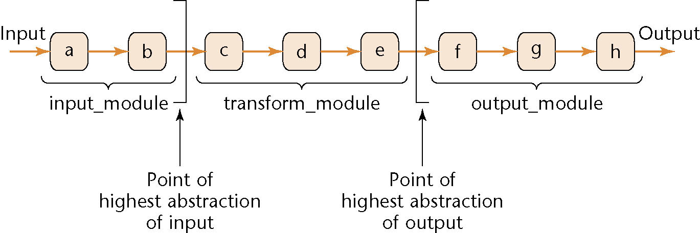
Data Flow Analysis
Every product transforms input into output
Determine
  “Point of highest abstraction of input”
  “Point of highest abstract of output”
Figure 13.2

Slide 9
Data Flow Analysis (contd)
Decompose the product into three modules
Repeat stepwise until each module has high cohesion
  Minor modifications may be needed to lower the coupling

Slide 10
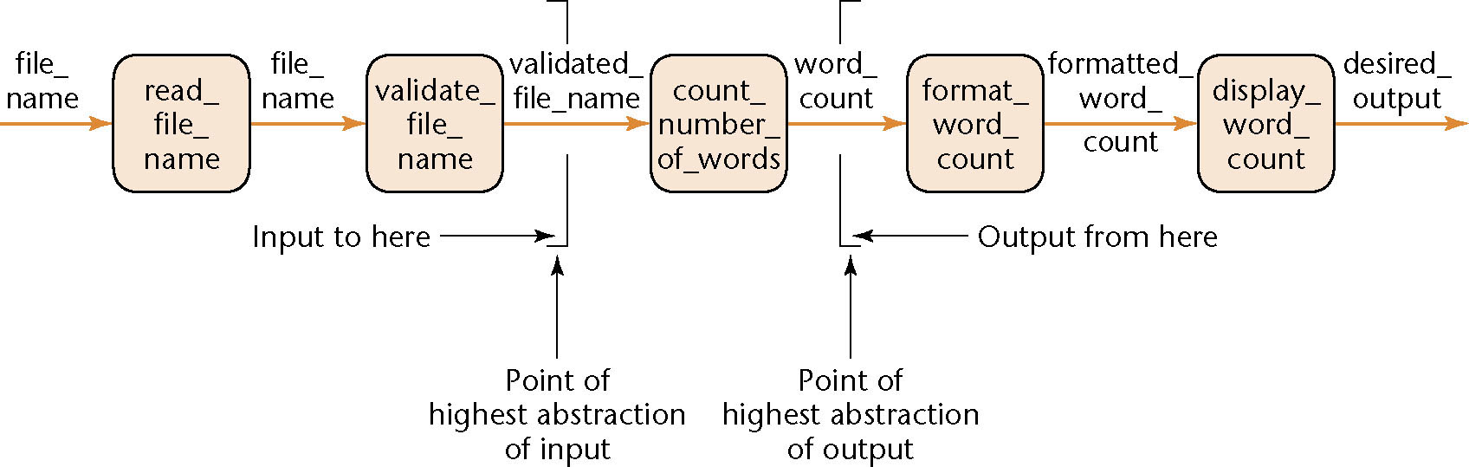
13.3.1 Mini Case Study: Word Counting
Example:
  Design a product which takes as input a file name, and returns the number of words in that file (like UNIX wc )
Figure 13.3

Slide 11
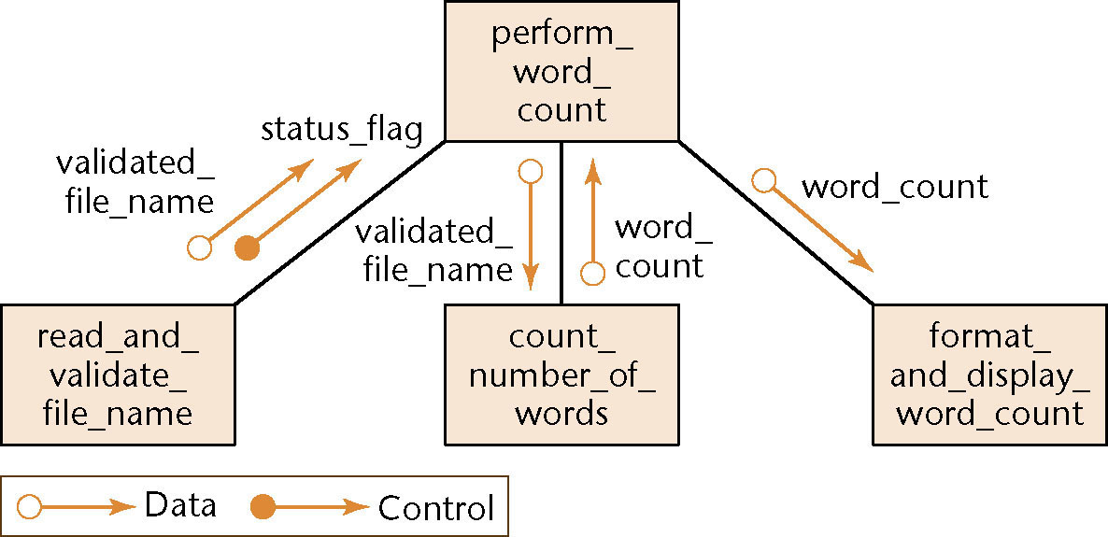
Mini Case Study: Word Counting (contd)
First refinement
Now refine the two modules of communicational cohesion
Figure 13.4

Slide 12
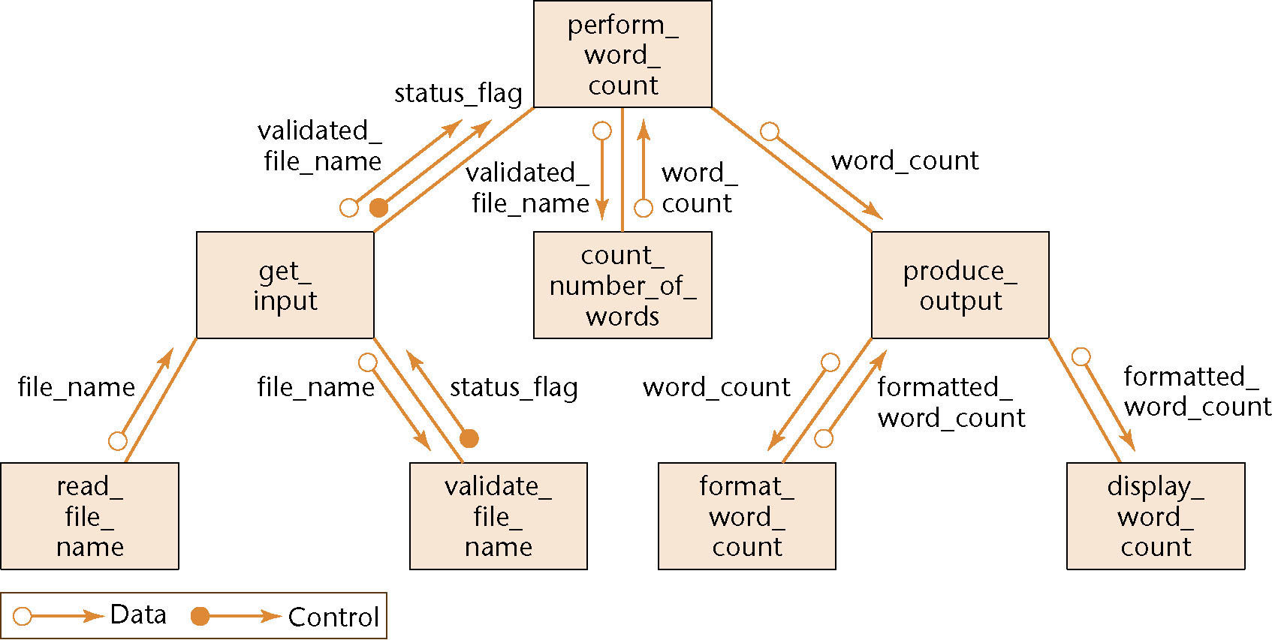
Mini Case Study: Word Counting (contd)
Second refinement
All eight modules now have functional cohesion
Figure 13.5

Slide 13
Word Counting: Detailed Design
The architectural design is complete
  So proceed to the detailed design
Two formats for representing the detailed design:
  Tabular
  Pseudocode (PDL — program design language)

Slide 14
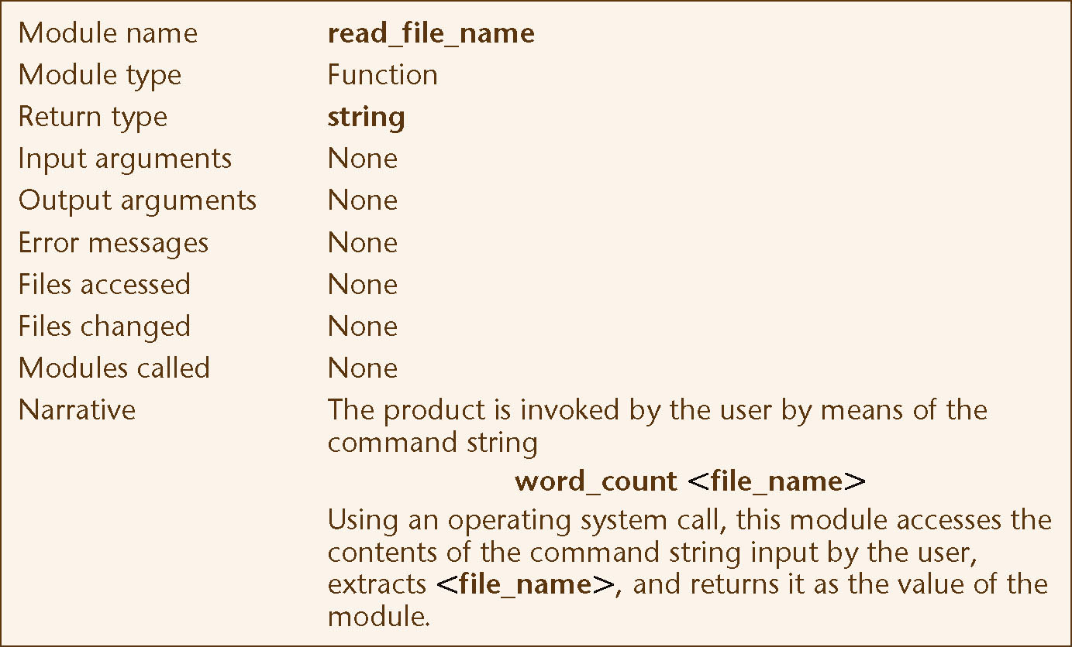
Detailed Design: Tabular Format
Figure 13.6(a)

Slide 15
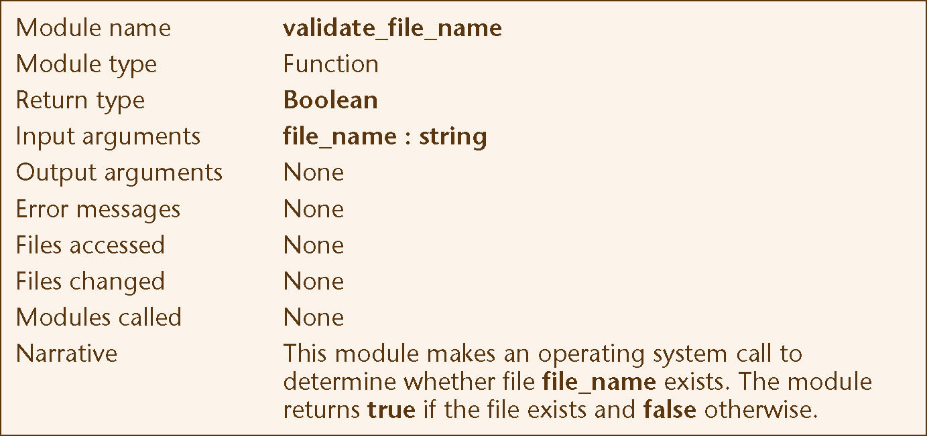
Detailed Design: Tabular Format (contd)
Figure 13.6(b)

Slide 16
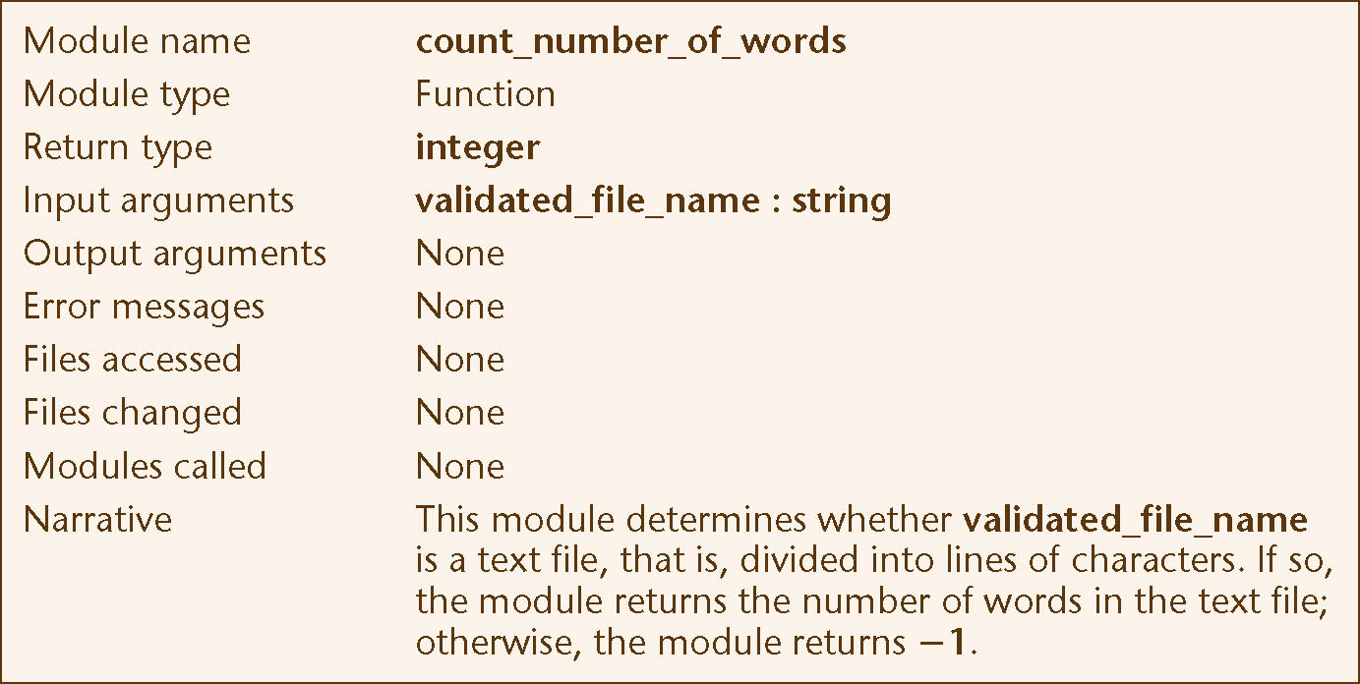
Detailed Design: Tabular Format (contd)
Figure 13.6(c)

Slide 17
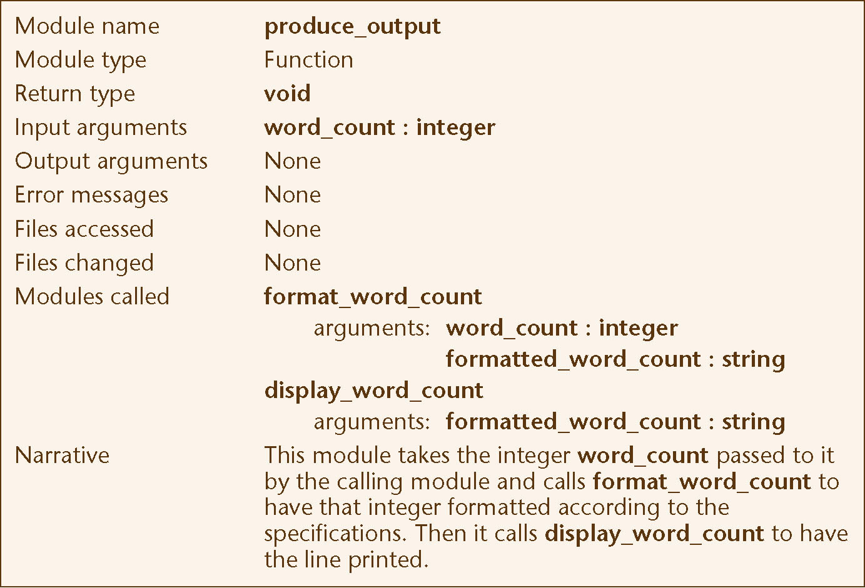
Detailed Design: Tabular Format (contd)
Figure 13.6(d)

Slide 18
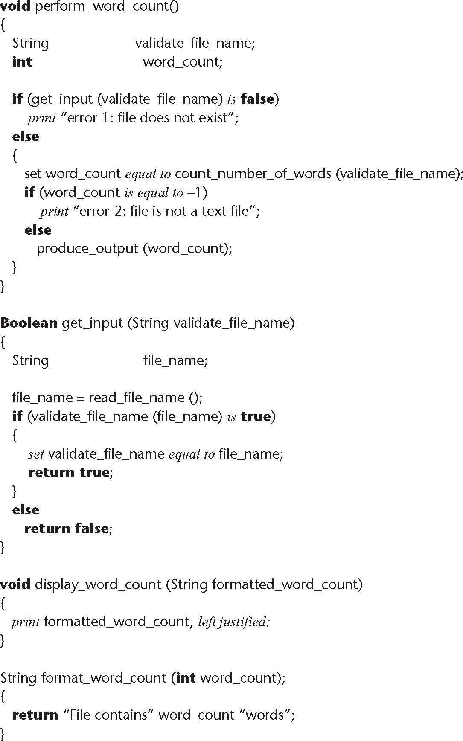
Detailed Design: PDL Format
Figure 13.7

Slide 19
13.3.2 Data Flow Analysis Extensions
In real-world products, there is
  More than one input stream, and
  More than one output stream

Slide 20
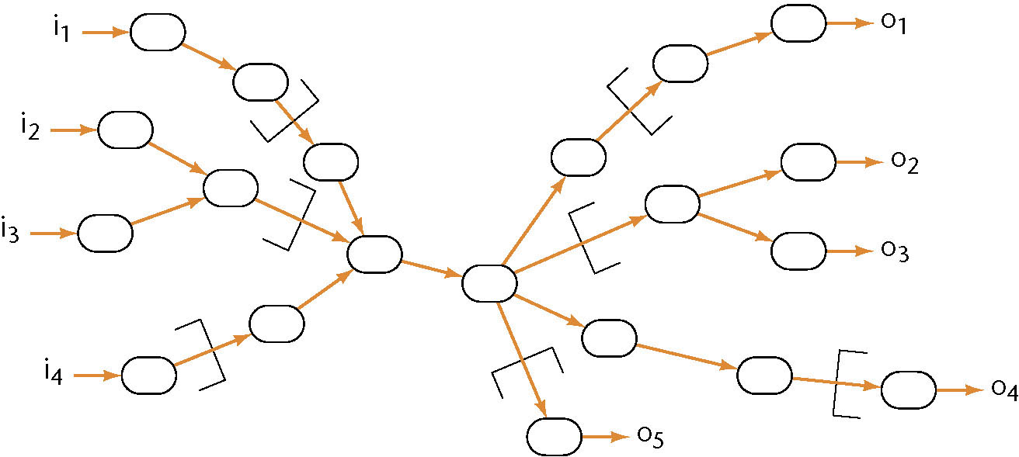
Data Flow Analysis Extensions (contd)
Find the point of highest abstraction for each stream
Continue until each module has high cohesion
  Adjust the coupling if needed
Figure 13.8

Slide 21
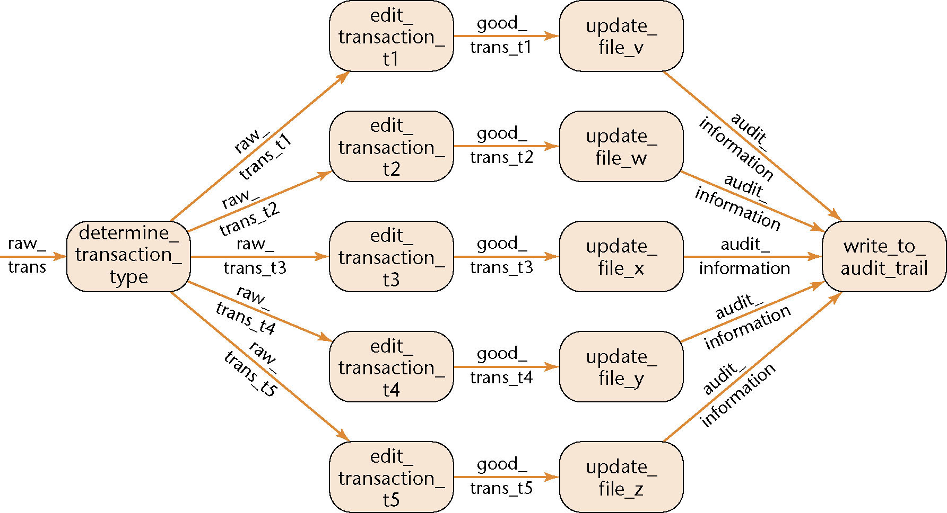
13.4 Transaction Analysis
DFA is poor for transaction processing products
  Example: ATM (automated teller machine)
Figure 13.9

Slide 22
Transaction Analysis (contd)
This is a poor design
  There is logical cohesion and control coupling

Slide 23
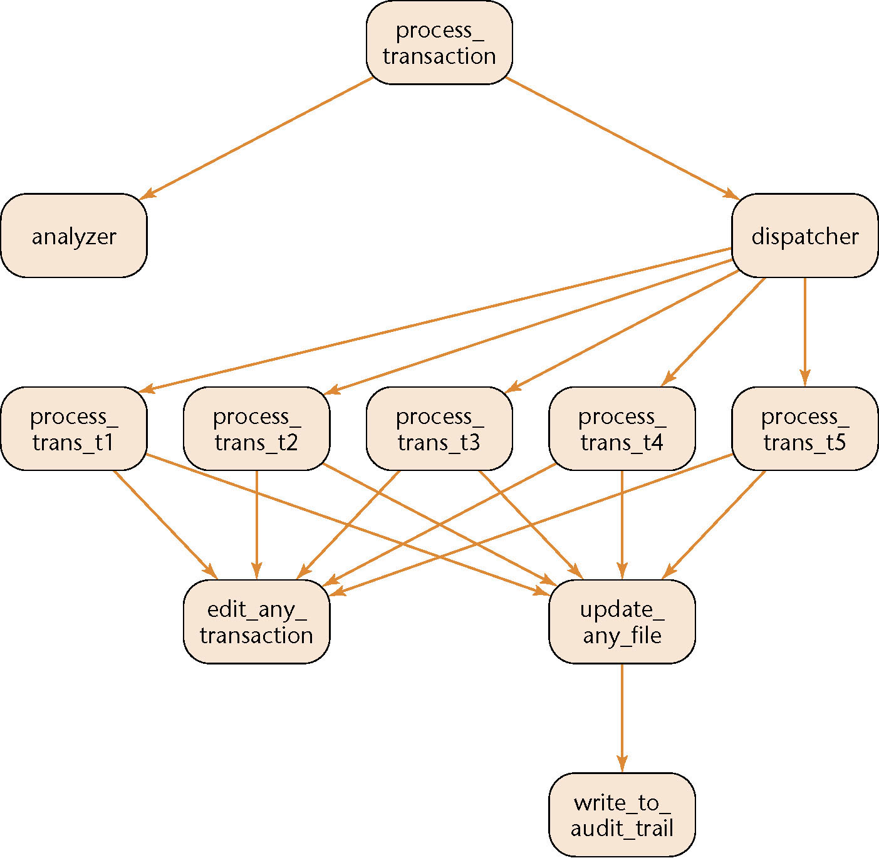
Corrected Design Using Transaction Analysis
Software reuse
Have one generic edit module, one generic update module
Instantiate them 5 times
Figure 13.10

Slide 24
13.5 Data-Oriented Design
Basic principle
  The structure of a product must conform to the structure of its data
Three very similar methods
  Michael Jackson [1975], Warnier [1976], Orr [1981]
Data-oriented design
  Has never been as popular as action-oriented design
  With the rise of OOD, data-oriented design has largely fallen out of fashion

Slide 25
13.6 Object-Oriented Design (OOD)
Aim
  Design the product in terms of the classes extracted during OOA
If we are using a language without inheritance (e.g., C, Ada 83)
  Use abstract data type design
If we are using a language without a type statement (e.g., FORTRAN, COBOL)
  Use data encapsulation

Slide 26
Object-Oriented Design Steps
OOD consists of two steps:
Step 1. Complete the class diagram
  Determine the formats of the attributes
  Assign each method, either to a class or to a client that sends a message to an object of that class
Step 2. Perform the detailed design

Slide 27
Object-Oriented Design Steps (contd)
Step 1. Complete the class diagram
  The formats of the attributes can be directly deduced from the analysis artifacts
Example: Dates
  U.S. format (mm/dd/yyyy)
  European format (dd/mm/yyyy)
  In both instances, 10 characters are needed
The formats could be added during analysis
  To minimize rework, never add an item to a UML diagram until strictly necessary

Slide 28
Object-Oriented Design Steps (contd)
Step 1. Complete the class diagram
  Assign each method, either to a class or to a client that sends a message to an object of that class
Principle A: Information hiding
Principle B: If an operation is invoked by many clients of an object, assign the method to the object, not the clients
Principle C: Responsibility-driven design

Slide 29
13.7 Object-Oriented Design: The Elevator Problem Case Study
Step 1. Complete the class diagram
Consider the second iteration of the CRC card for the elevator controller

Slide 30
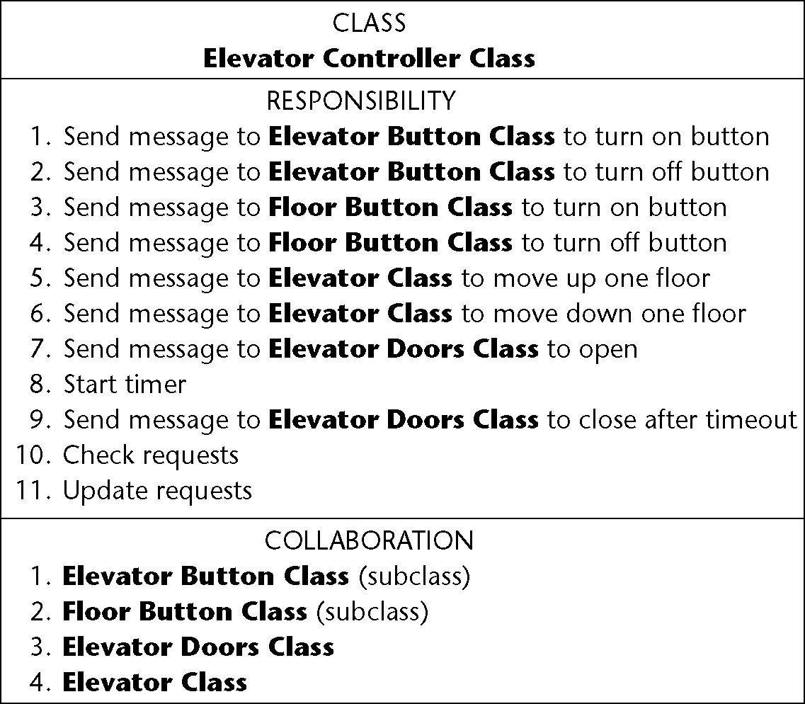
OOD: Elevator Problem Case Study (contd)
CRC card
Figure 12.9 (again)

Slide 31
OOD: Elevator Problem Case Study (contd)
Responsibilities
  8. Start timer
  10. Check requests, and
  11. Update requests
are assigned to the elevator controller
Because they are carried out by the elevator controller

Slide 32
OOD: Elevator Problem Case Study (contd)
The remaining eight responsibilities have the form
  “Send a message to another class to tell it do something”
These should be assigned to that other class
  Responsibility-driven design
  Safety considerations
Methods open doors, close doors are assigned to class Elevator Doors Class
Methods turn off button, turn on button are assigned to classes Floor Button Class and Elevator Problem Class

Slide 33
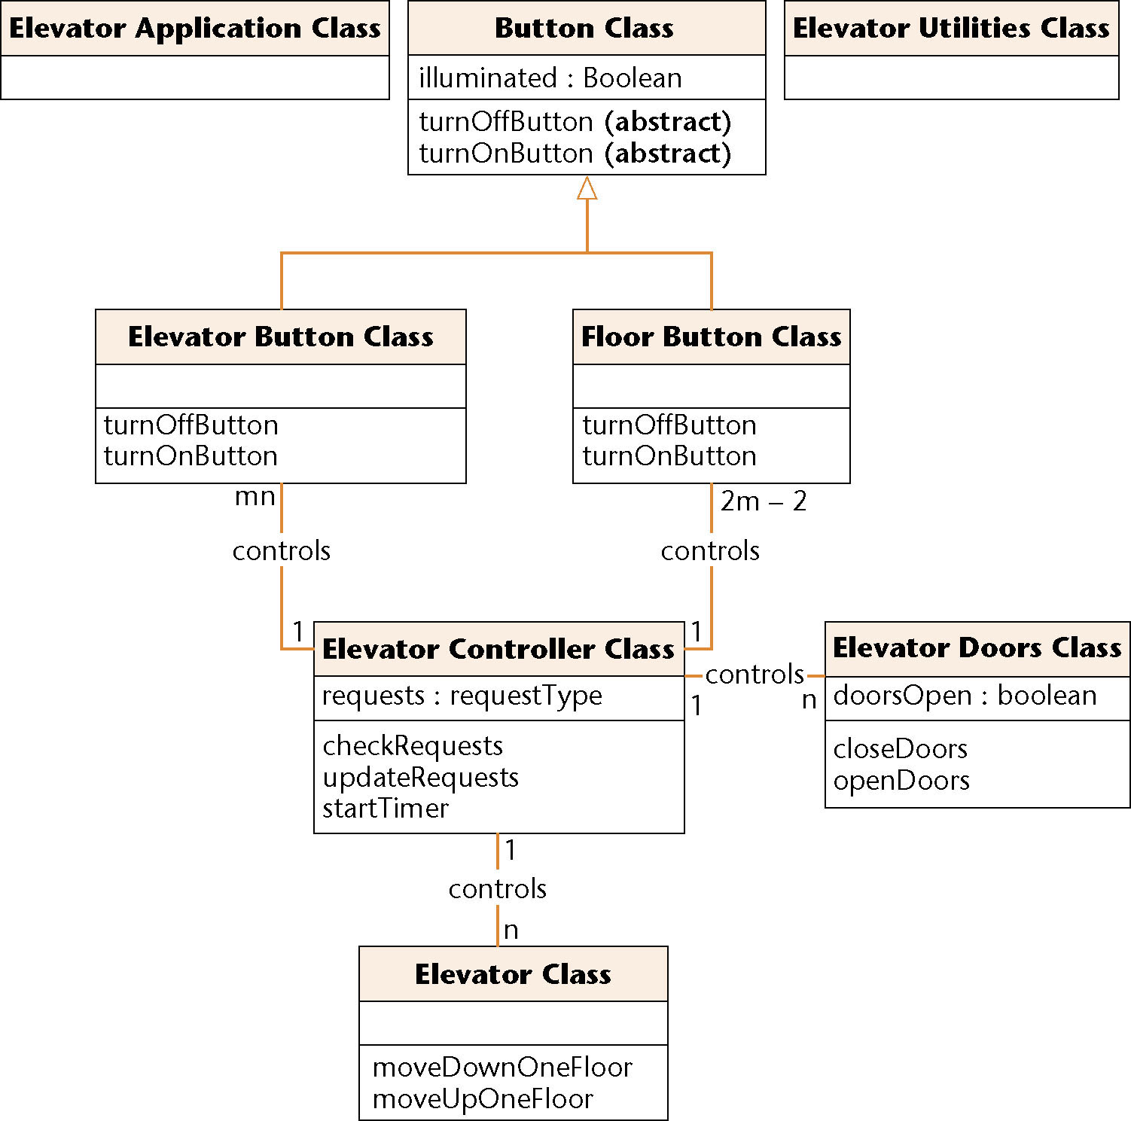
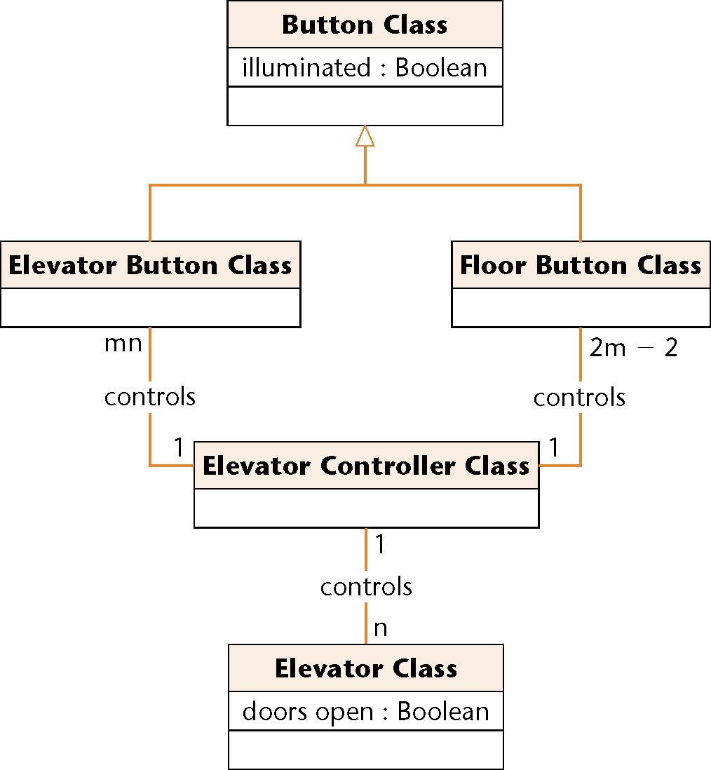
Detailed Class Diagram: Elevator Problem
Figure 13.11

Slide 34
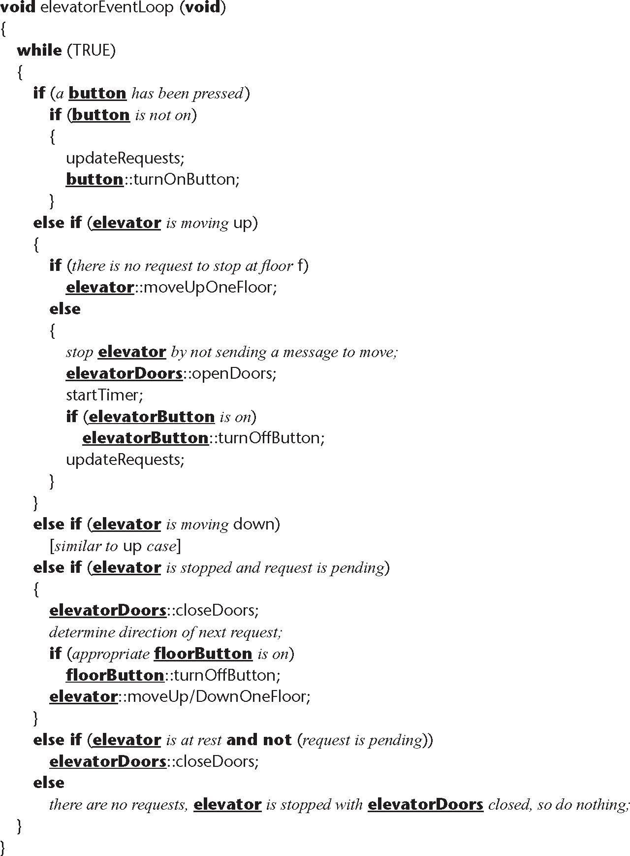
Detailed Design: Elevator Problem
Detailed design of elevatorEventLoop is constructed from the statechart
Figure 13.12

Slide 35
13.8 Object-Oriented Design: The MSG Foundation Case Study
Step 1. Complete the class diagram
The final class diagram is shown in the next slide
  Date Class is needed for C++
  Java has built-it functions for handling dates

Slide 36
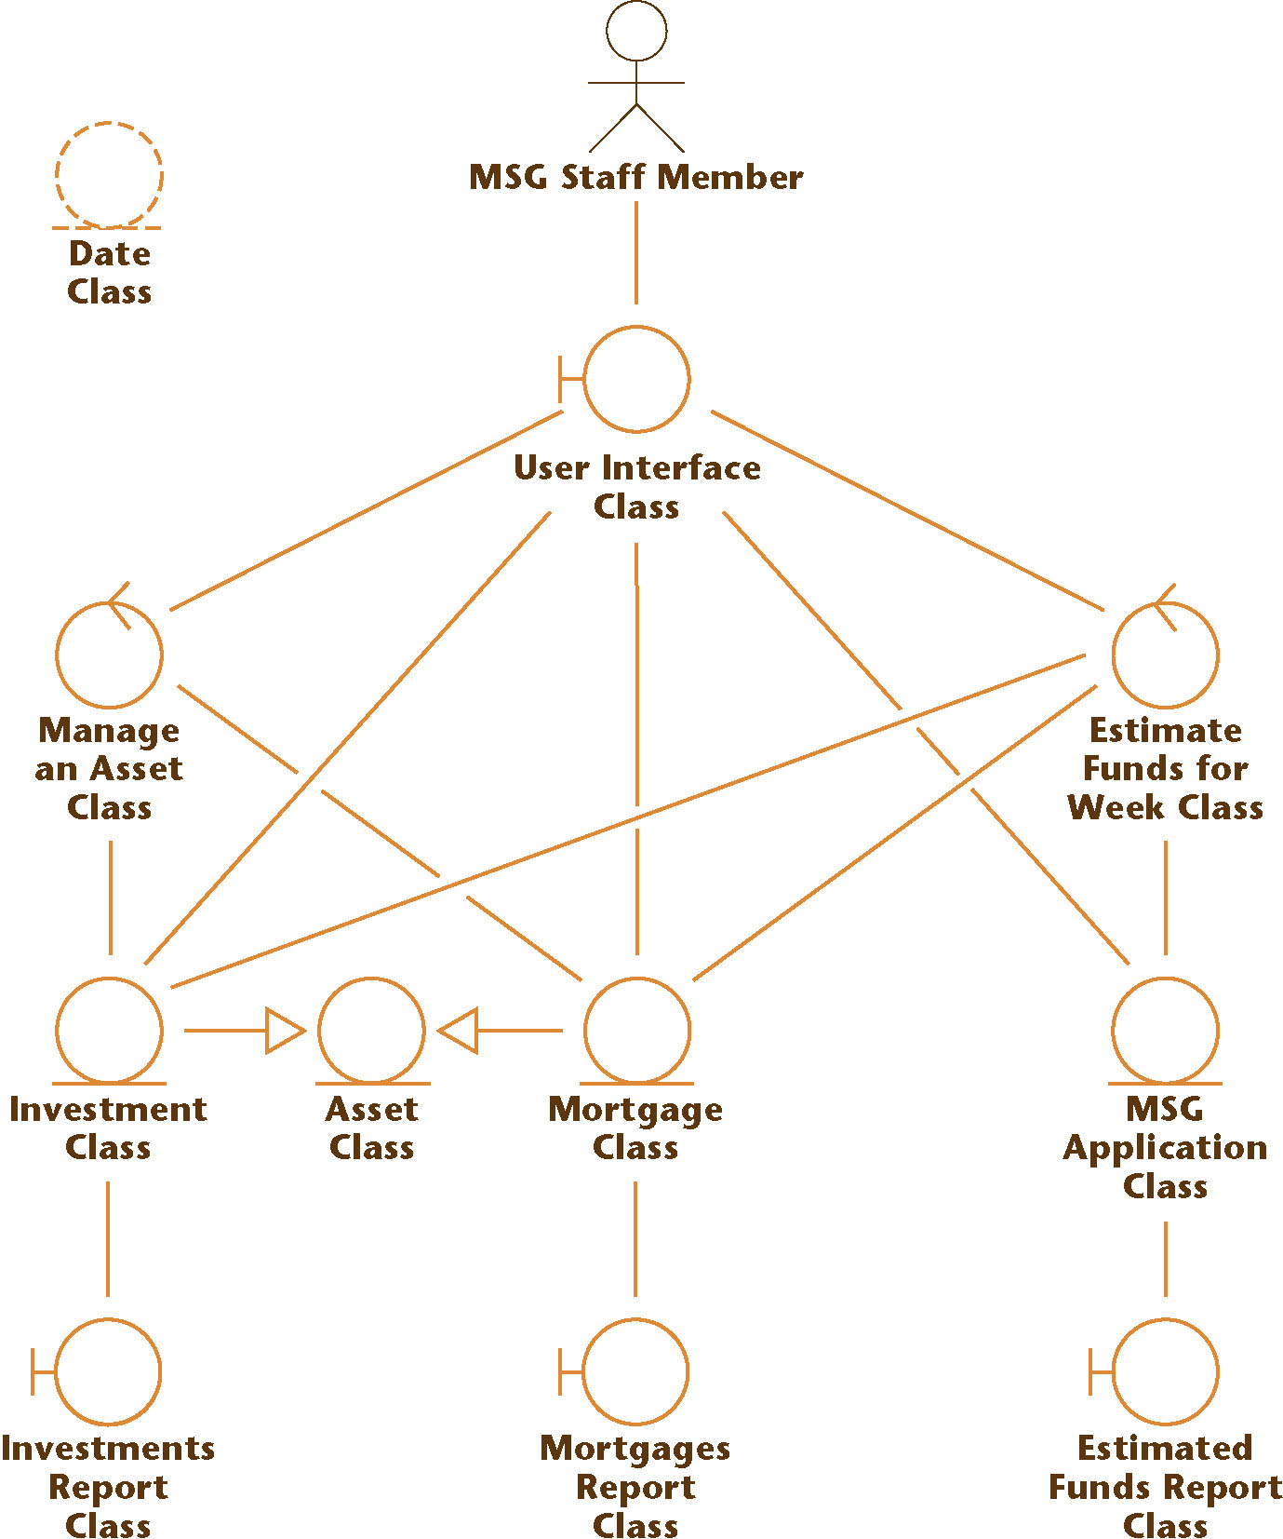
Final Class Diagram: MSG Foundation
Figure 13.13

Slide 37
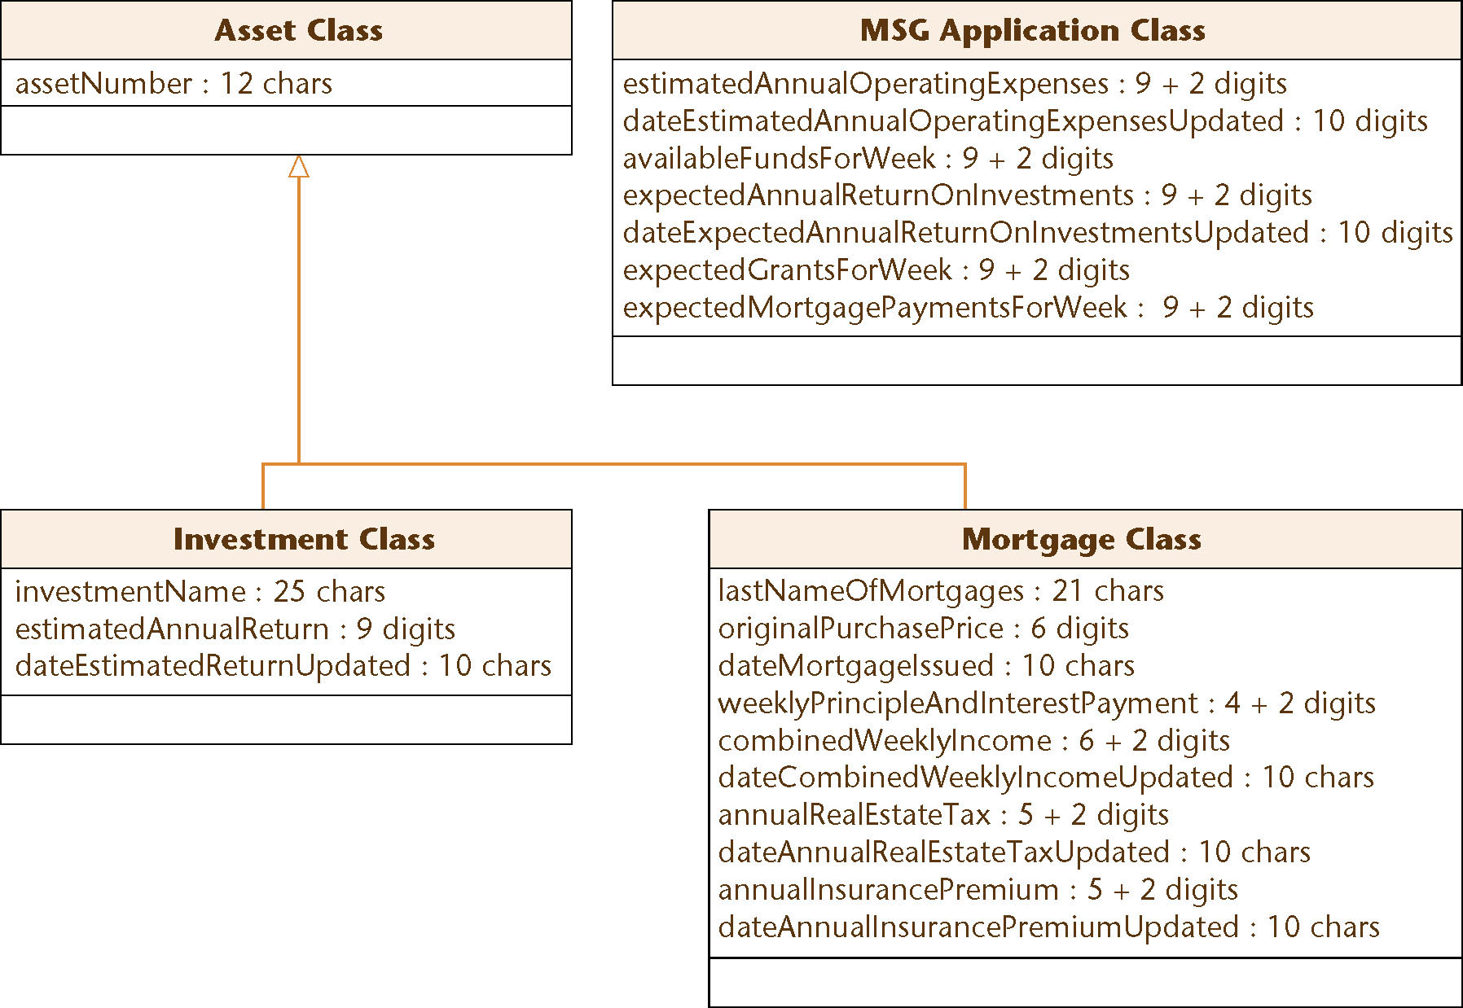
Class Diagram with Attributes: MSG Foundation
Figure 13.14

Slide 38
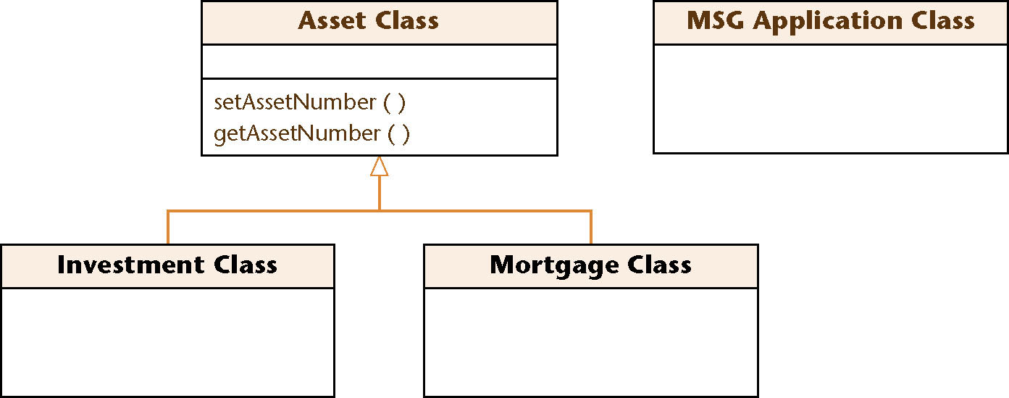
Assigning Methods to Classes: MSG Foundation
Example: setAssetNumber, getAssetNumber
  From the inheritance tree, these accessor/mutator methods should be assigned to Asset Class
  So that they can be inherited by both subclasses of Asset Class (Investment Class and Mortgage Class)
Figure 13.15

Slide 39
Assigning Methods to Classes: MSG Foundation (contd)
Assigning the other methods is equally straightforward
  See Appendix G

Slide 40
Detailed Design: MSG Foundation
Determine what each method does
Represent the detailed design in an appropriate format
  PDL (pseudocode) here

Slide 41
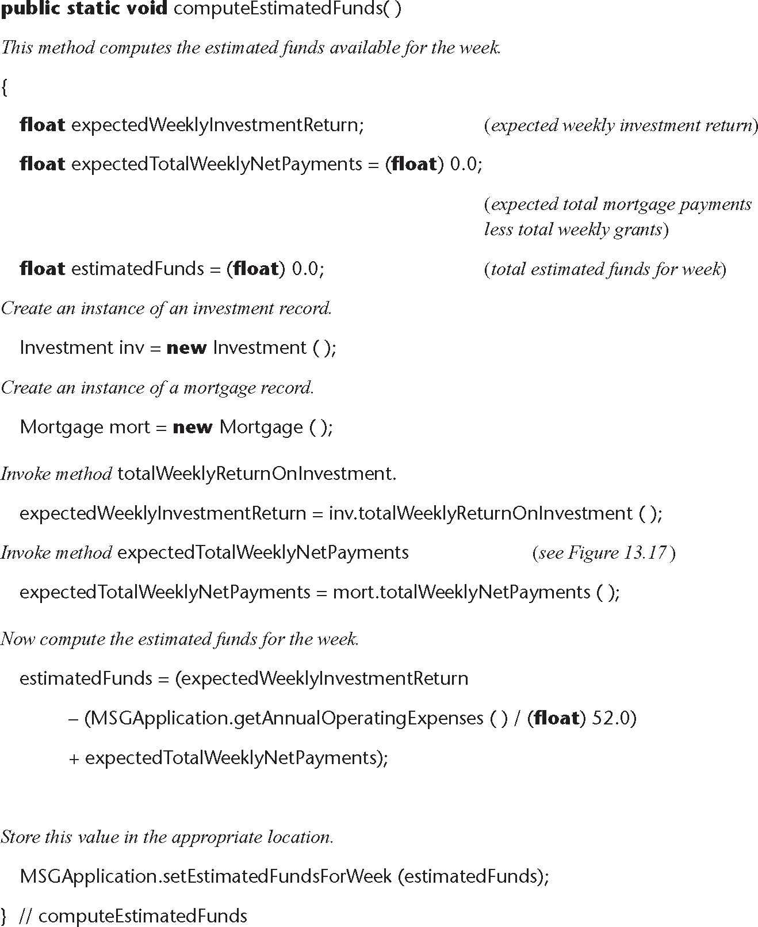
Method EstimateFundsForWeek::computeEstimatedFunds
Figure 13.16

Slide 42

Method Mortgage::totalWeeklyNetPayments
Figure 13.17

Slide 43
13.9 The Design Workflow
Summary of the design workflow:
  The analysis workflow artifacts are iterated and integrated until the programmers can utilize them
Decisions to be made include:
  Implementation language
  Reuse
  Portability

Slide 44
The Design Workflow (contd)
The idea of decomposing a large workflow into independent smaller workflows (packages) is carried forward to the design workflow
The objective is to break up the upcoming implementation workflow into manageable pieces
  Subsystems
It does not make sense to break up the MSG Foundation case study into subsystems — it is too small

Slide 45
The Design Workflow (contd)
Why the product is broken into subsystems:
  It is easier to implement a number of smaller subsystems than one large system
  If the subsystems are independent, they can be implemented by programming teams working in parallel
    The software product as a whole can then be delivered sooner

Slide 46
The Design Workflow (contd)
The architecture of a software product includes
  The various components
  How they fit together
  The allocation of components to subsystems
The task of designing the architecture is specialized
  It is performed by a software architect

Slide 47
The Design Workflow (contd)
The architect needs to make trade-offs
  Every software product must satisfy its functional requirements (the use cases)
  It also must satisfy its nonfunctional requirements, including
    Portability, reliability, robustness, maintainability, and security
  It must do all these things within budget and time constraints
The architect must assist the client by laying out the trade-offs

Slide 48
The Design Workflow (contd)
It is usually impossible to satisfy all the requirements, functional and nonfunctional, within the cost and time constraints
  Some sort of compromises have to be made
The client has to
  Relax some of the requirements;
  Increase the budget; and/or
  Move the delivery deadline

Slide 49
The Design Workflow (contd)
The architecture of a software product is critical
  The requirements workflow can be fixed during the analysis workflow
  The analysis workflow can be fixed during the design workflow
  The design workflow can be fixed during the implementation workflow
But there is no way to recover from a suboptimal architecture
  The architecture must immediately be redesigned

Slide 50
13.10 The Test Workflow: Design
Design reviews must be performed
  The design must correctly reflect the specifications
  The design itself must be correct
Transaction-driven inspections
  Essential for transaction-oriented products
  However, they are insufficient — specification-driven inspections are also needed

Slide 51
13.11 The Test Workflow: The MSG Foundation Case Study
A design inspection must be performed
  All aspects of the design must be checked
Even if no faults are found, the design may be changed during the implementation workflow

Slide 52
13.12 Formal Techniques for Detailed Design
Implementing a complete product and then proving it correct is hard
However, use of formal techniques during detailed design can help
  Correctness proving can be applied to module-sized pieces
  The design should have fewer faults if it is developed in parallel with a correctness proof
  If the same programmer does the detailed design and implementation
    The programmer will have a positive attitude to the detailed design
    This should lead to fewer faults

Slide 53
13.13 Real-Time Design Techniques
Difficulties associated with real-time systems
  Inputs come from the real world
    Software has no control over the timing of the inputs
  Frequently implemented on distributed software
    Communications implications
    Timing issues
  Problems of synchronization
    Race conditions
    Deadlock (deadly embrace)

Slide 54
Real-Time Design Techniques (contd)
The major difficulty in the design of real-time systems
  Determining whether the timing constraints are met by the design

Slide 55
Real-Time Design Techniques (contd)
Most real-time design methods are extensions of non-real-time methods to real-time
We have limited experience in the use of any real-time methods
The state-of-the-art is not where we would like it to be

Slide 56
13.14 CASE Tools for Design
It is critical to check that the design artifacts incorporate all aspects of the analysis
  To handle analysis and design artifacts we therefore need upperCASE tools
UpperCASE tools
  Are built around a data dictionary
  They incorporate a consistency checker, and
  Screen and report generators
  Management tools are sometimes included, for
    Estimating
    Planning

Slide 57
CASE Tools for Design (contd)
Examples of tools for object-oriented design
  Commercial tools
    Software through Pictures
    IBM Rational Rose
    Together
  Open-source tool
    ArgoUML

Slide 58
13.15 Metrics for Design
Measures of design quality
  Cohesion
  Coupling
  Fault statistics
Cyclomatic complexity is problematic
  Data complexity is ignored
  It is not used much with the object-oriented paradigm

Slide 59
Metrics for Design (contd)
Metrics have been put forward for the object-oriented paradigm
  They have been challenged on both theoretical and experimental grounds

Slide 60
13.16 Challenges of the Design Phase
The design team should not do too much
  The detailed design should not become code
The design team should not do too little
  It is essential for the design team to produce a complete detailed design

Slide 61
Challenges of the Design Phase (contd)
We need to “grow” great designers
Potential great designers must be
  Identified,
  Provided with a formal education,
  Apprenticed to great designers, and
  Allowed to interact with other designers
There must be a specific career path for these designers, with appropriate rewards

